Slide 1
Continuation of Go2 Navigation Project Process Book
Trevecca Nazarene University
Web Portfolio Capstone Experience
CIT-4960-O003
Project B
Joshua T. Lomelino

Slide 2
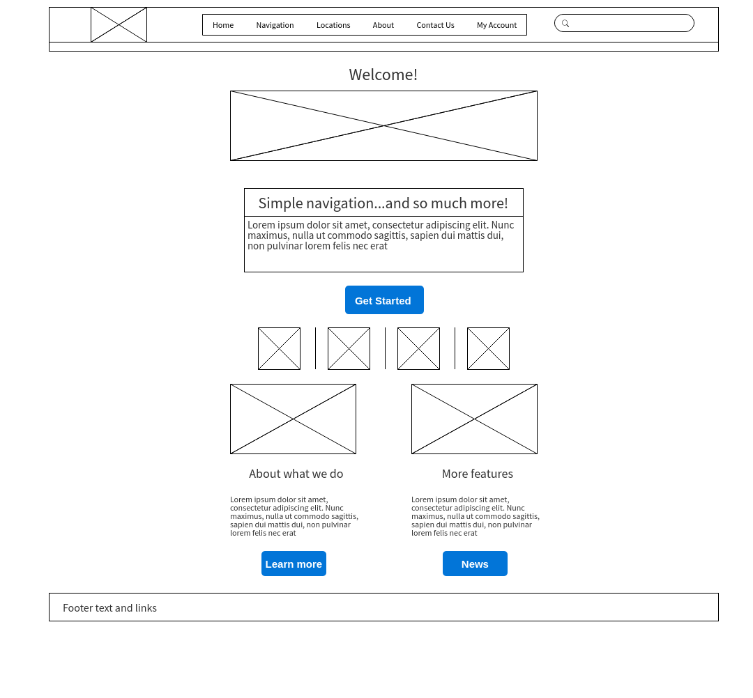
Original Home Page Design, Re-rendered

Slide 3
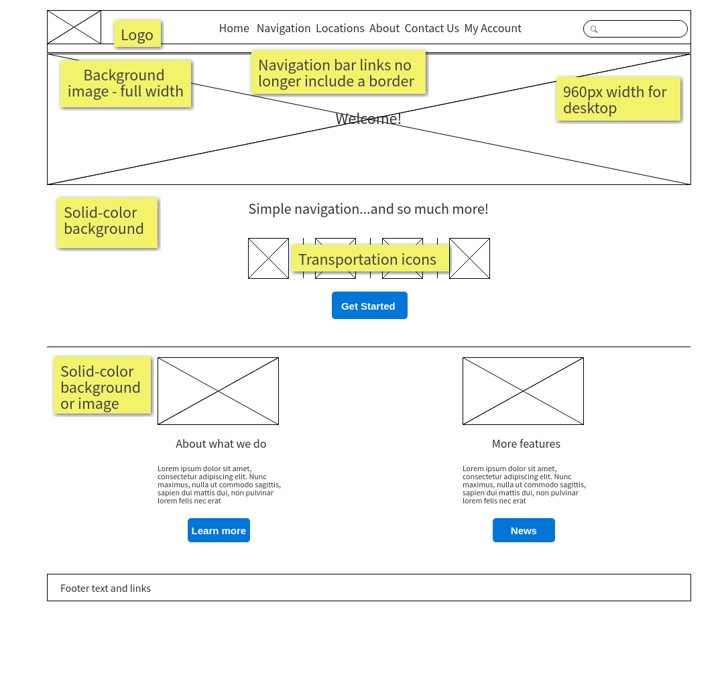
New Home Page Design, basic mockup

Slide 4
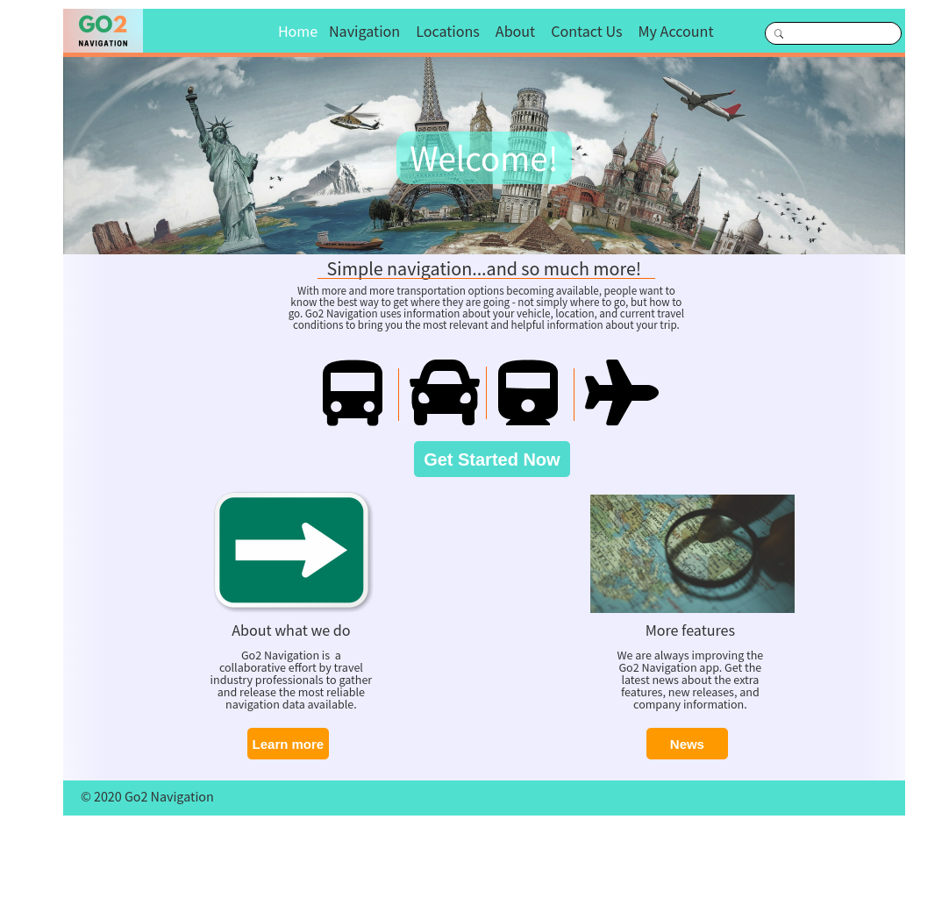
Home Page Design, refinished

Slide 5
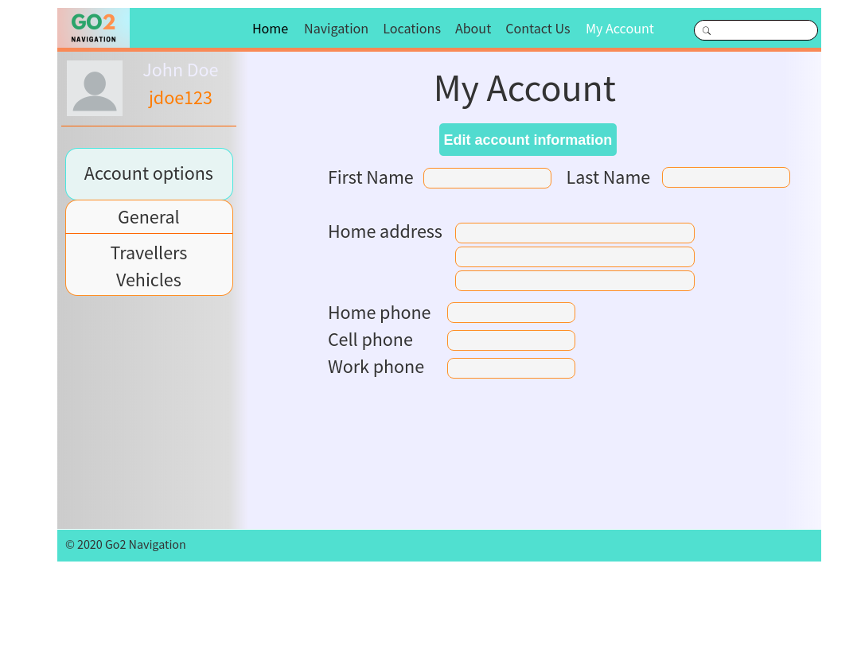
Account page

Slide 6
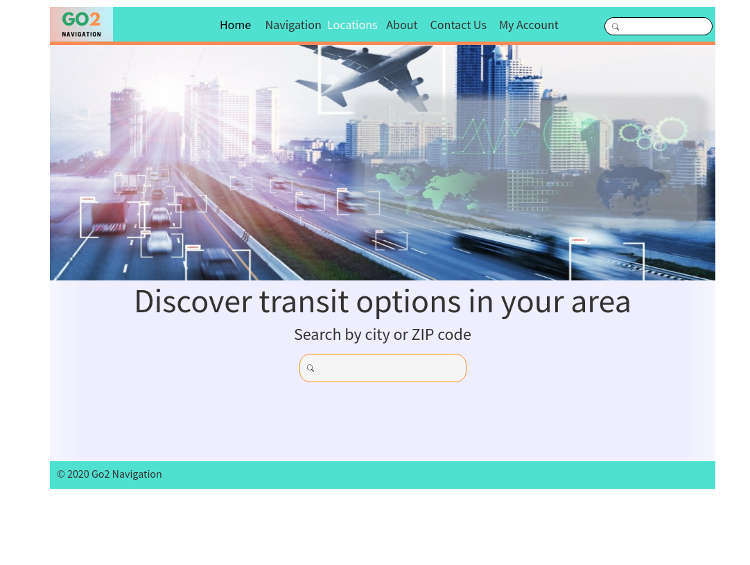
Locations page

Slide 7
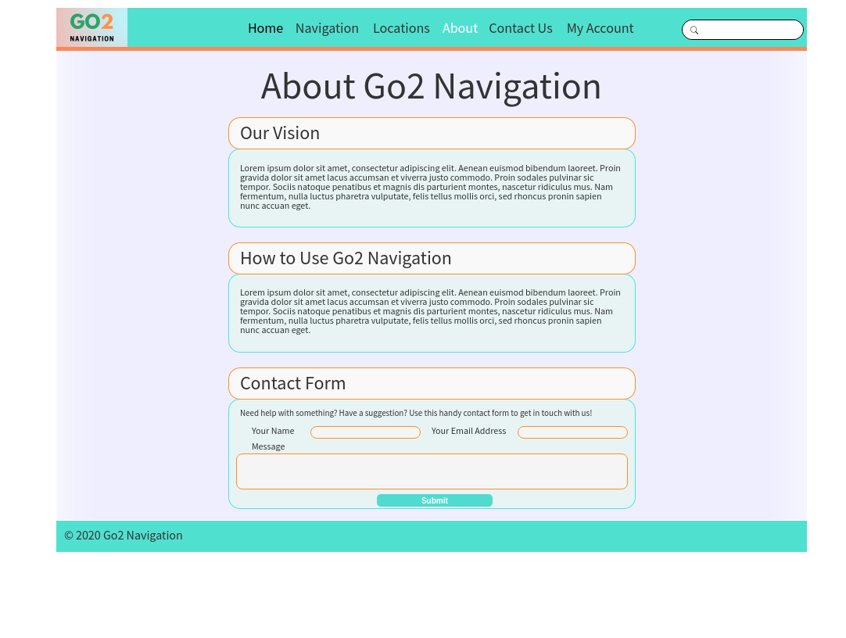
About page

Slide 8
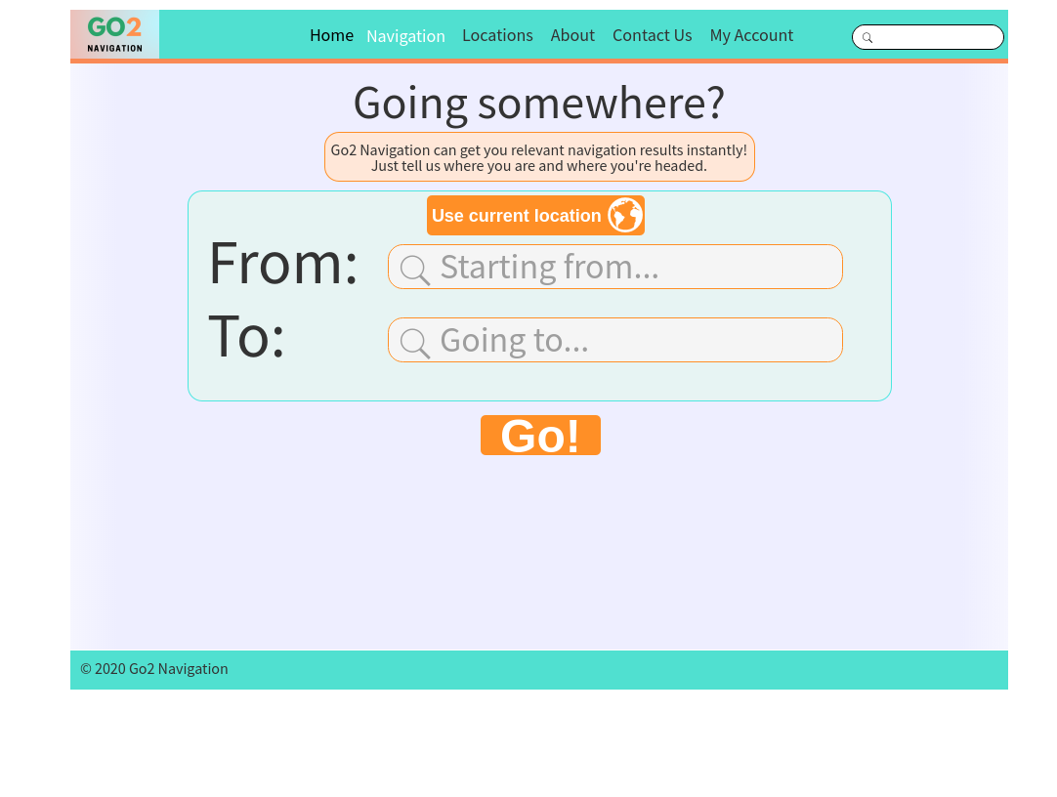
Navigation input page

Slide 9
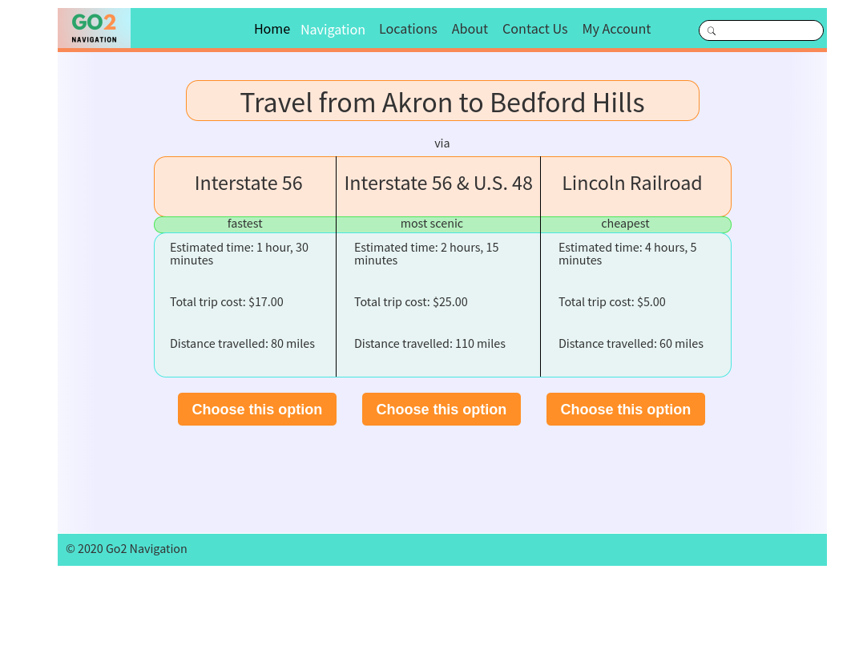
Navigation results page

